Slide 1
JAVA GARBAGE COLLECTION
SHREEKAR MAYYA S
Tricon Infotech

Slide 2
Outline
Overview
Types of memory locations in Heap
How GC works ?
Types of GC
How to use GC in your program ?
Selection of GC
Demonstration
References

Slide 3
Overview of GC
GC is a demon thread which does automatic memory management in Java.
It removes unused or unreachable objects from the memory location.
Hypothesis in GC
Most of the objects soon becomes unreachable
Reference from old objects to new objects only exist in less number

Slide 4
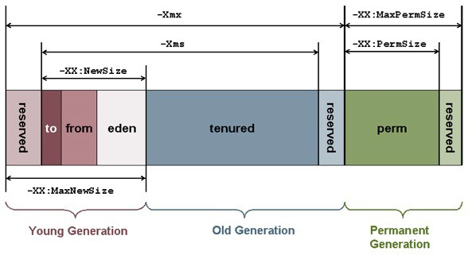
Types of Memory Locations

Slide 5
Types of Memory Locations(Contd)
Young Generation
It is memory location where objects are created initially(New objects).It is again split into 2 memory locations Eden space and Survivor.
Old generation
It is a memory location which holds an old objects which is survived for a long time in the memory.

Slide 6
How GC Works ?
Mark
Marks the objects that are live or reachable.
Delete/Sweep
Deletes the unreachable objects from memory.
Compact
Works similar to Disk Defragmentation in OS.

Slide 7
Types of GC in java
Serial GC
Parallel GC
CMS GC
G1 GC

Slide 8
Serial GC
It uses a single thread for the garbage collection.
It works by stalling the application threads which encounters delay in the application.
Delay is called Stop the world which freezes the application.
It is suited for simple command line programs.
JVM Argument:- -XX:+UseSerialGC

Slide 9
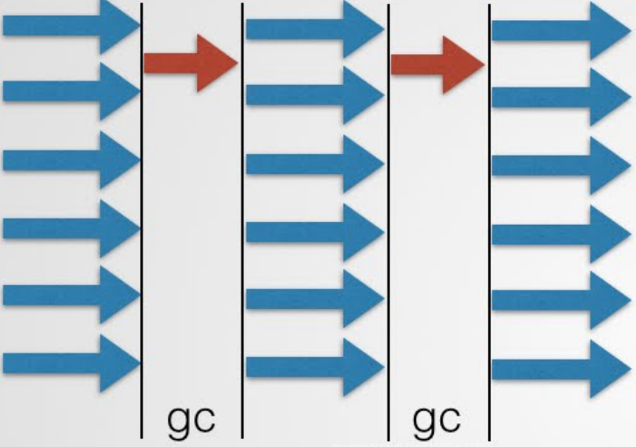

Slide 10
Parallel GC
It uses a multiple thread for the garbage collection.
It works by stalling the application threads which encounters delay in the application.
It is called as throughput collector.
It is default GC in java 8
JVM Argument:- -XX:+UseParallelGC

Slide 11
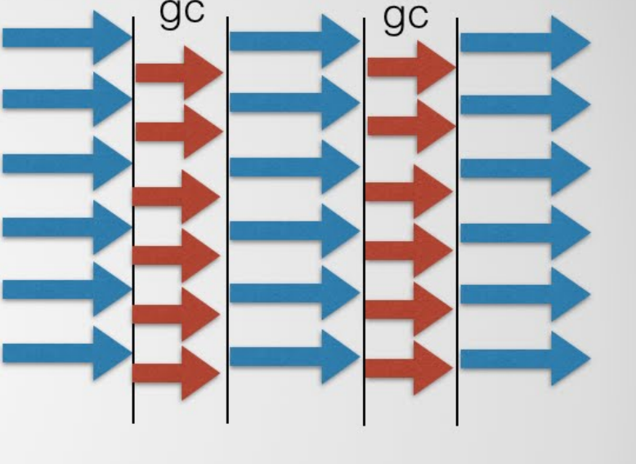

Slide 12
CMS GC
It uses a multiple thread for the garbage collection .It does not wait for the old generation to full.
It stalls the application only in following condition:-
Mark
If there is a change in the heap memory in parallel while doing GC.(Remark)
It uses more CPU cycles compared to parallel GC.
Par new GC is deprecated in java 8
JVM Argument:- -XX:+UseConcMarkSweepGC

Slide 13
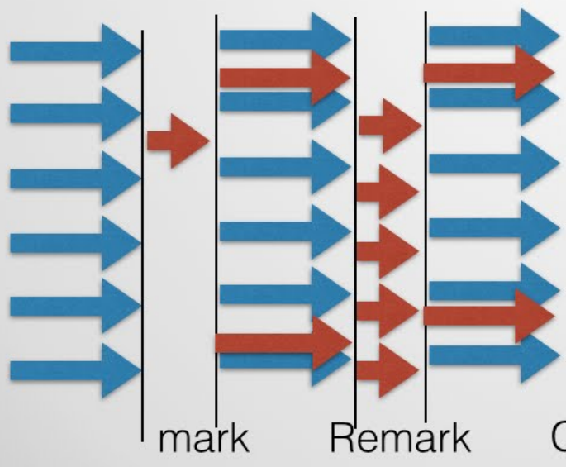

Slide 14
G1 GC
It is a new type of GC introduced in java 1.7 u 4
It divides the heap memory into smaller regions and does collection in parallel.
As the name suggest it is Garbage first collector which collects unreachable object from the location with most garbage.
It is combination of Parallel and CMS GC ,with tuneable GC pauses.
JVM Argument:- -XX:+UseG1GC (String Dedublication)

Slide 15


Slide 16
Commands for GC
Command Options | Resulting Collector Combination
-XX:+UseSerialGC | young Copy and old MarkSweepCompact
-XX:+UseG1GC | young G1 Young and old G1 Mixed
-XX:+UseParallelGC -XX:+UseParallelOldGC -XX:+UseAdaptiveSizePolicy | young PS Scavenge old PS MarkSweep
XX:+UseParNewGC (deprecated in Java 8) | young ParNew old MarkSweepCompact
-XX:+UseConcMarkSweepGC -XX:+UseParNewGC | young ParNew old ConcurrentMarkSweep
-XX:+UseConcMarkSweepGC -XX:-UseParNewGC (deprecated in Java 8 and removed in Java 9) | young Copy old ConcurrentMarkSweep

Slide 17
Selection of GC
Use CMS GC when there is more memory and high number of CPUs , and application should not have more pause due to GC.
Use Parallel GC when there is less memory and less CPUs, and application demands more throughput and can have pauses.

Slide 18
Demonstration

Slide 19
References
www.oracle.com
www.hackerearth.com
www.javapapers.com
www.gceasy.io

Slide 20
Any queries ?

Slide 21
Thank you

